Slide 1
CPR:
Reviving 20-Somethings in your Congregation
January 19th, 2026

Slide 2
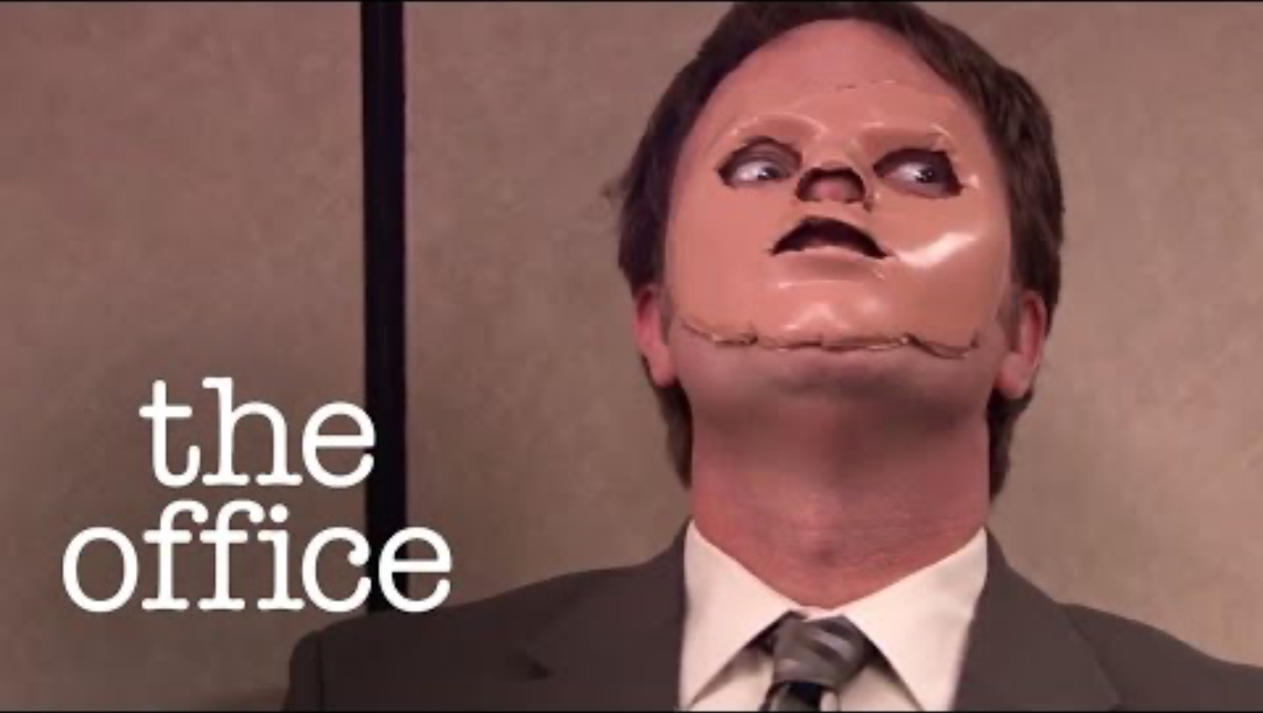
Notes:
Love the video, sorry I missed it the first time, thus we could have avoided to QR or not to QR code drama. ☺

Slide 3
Who are we?

Slide 4
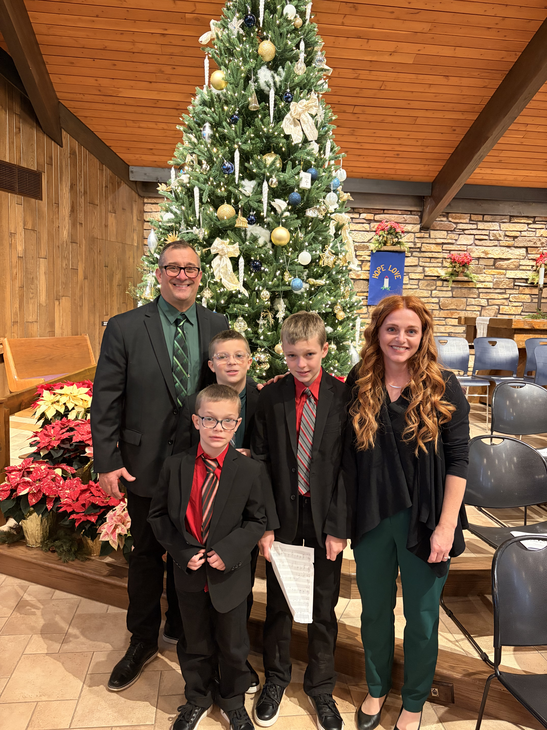
Pastor Clark (PC)
Notes:
Johnson Creek
Hawkdome
Northwestern Prep
Northwestern College
Tutor LPS
Seminary 1999
Cedar Grove
Luther Prep recruiter
Lakeside
SOTH WEST BEND

Slide 5
Abby, Stella, Jared

Slide 6
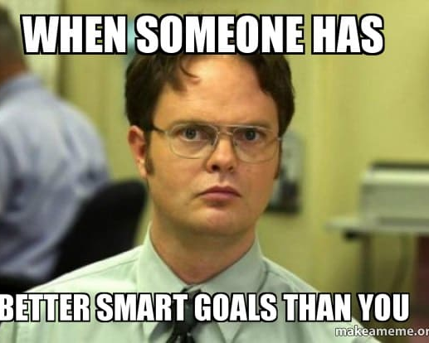
Goals
Explain
Provide
Discuss
Notes:
PC = PC will like a sermon, lay out the 3 points WE as a group hope to discuss…
Explain how to use CPR method to assess and improve 20 somethings participation in the church
Provide examples of what has worked at Shepherd of the Hills Lutheran Church
Discuss and clarify any questions from your church
This doesn’t mean our church is perfect, just what we’ve done that has worked for us

Slide 7

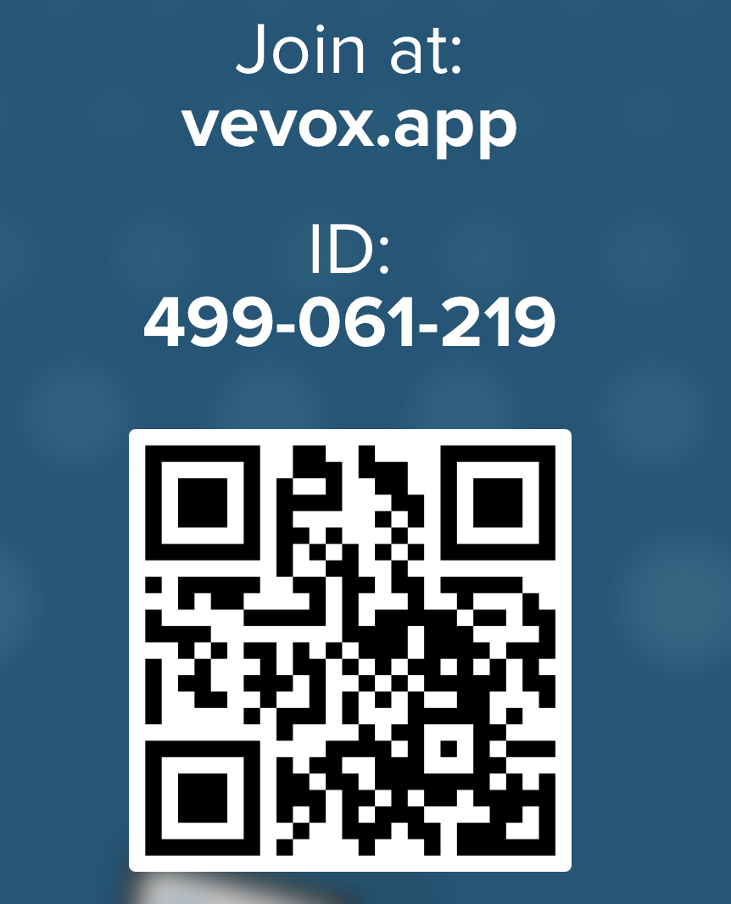
Brainstorming
Take the next minute to talk with your neighbor or to write down questions you may have about how to incorporate and include 20 somethings in church.
Notes:
Make it a minute timer – put the QR code in the timer spot
I’m will add a program here tomorrow on “live QR codes that folks can submit a question)

Slide 8
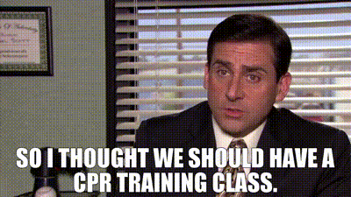
Just find one key takeaway…
Don’t be overwhelmed
Notes:
PC tells story of his FIRST missionary conference and his frustrations of feeling overwhelmed….FIND ONE thing that may work for your particular setting

Slide 9



Other resources and books to help foster growth
This Photo by Unknown Author is licensed under CC BY-ND
Notes:
Some suggested reading….

Slide 10
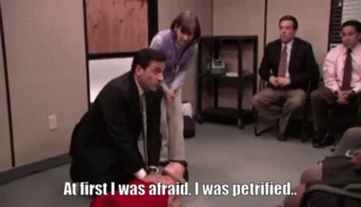
CPR
Culture
Personality
Relationships

Slide 11

Culture
Assess your current culture and identify areas of growth
Ask your Elders and congregation “What do we want our church to look like”
Create a space for community to thrive
Fellowship
Encourage people to stick around after church
Notes:
PC will start this slide and then kick it to Abby to QB to add her points and if needed kick it to Jared and Stella….
JP notes/additional points
-encouragement to use gifts in the church from young age - (at this point I think I’ll talk about how valuable it’s been for me to grow up in the church at SOTH being welcomed to use my musical gifts)
-adapt to style of worship needs for congregation
-desire to reach 20 somethings/recognition of a need
Stella notes - take charge in your congregation, don’t just wait around for someone else to do it, be the person to start it

Slide 12
Culture
Create a culture of taking ownership of your faith
Foster from grade school age and on
(ex. junior ushers, greeters, bible presentations, liturgy readers, Christmas children's services, musical involvement -leading worship, offering music)
Engagement throughout the ages
Lead by example
Intentionally welcome in 20 somethings
Make space for 20 somethings to serve
Notes:
After discussion of Previous slide, here too PC will start this slide and then kick it to Abby to QB to add her points and if needed kick it to Jared and Stella….
JP notes/additional points
-encouragement to use gifts in the church from young age - (at this point I think I’ll talk about how valuable it’s been for me to grow up in the church at SOTH being welcomed to use my musical gifts) SPEAK AFTER CREATING A CULTURE OF TAKING OWNERSHIP
-adapt to style of worship needs for congregation
-desire to reach 20 somethings/recognition of a need
Stella notes - take charge in your congregation, don’t just wait around for someone else to do it, be the person to start it

Slide 13
Personality
Identify Pastors or members of the congregation with a fire to incorporate 20 somethings
Use the body of Christ
1 Corinthians 12
“Now you are the body of Christ, and each one of you is a part of it. 28 And God has placed in the church first of all apostles, second prophets, third teachers, then miracles, then gifts of healing, of helping, of guidance, and of different kinds of tongues.”
Notes:
PC will take this slide and discuss the blessings of the body of Christ, if not you, then ask for help as we are IN THIS TOGETHER.

Slide 14
Personality
Be authentic
It’s ok to be awkward
Include examples that apply to 20 somethings in sermons
(ex. fostering Christian friendships, leading a Godly life in any vocation, trusting God to help you discover purpose and direction for your life)
Notes:
PC will start this slide, but kick it to Abby to QB and she will add her points and if needed incorporate any points Jared and Stella make here too.

Slide 15
Relationships
Identify - the 20 somethings in your church currently
Foster - individual relationships with them
Nurture – relationships from youth group and on
Notes:
Abby will take this slide to start with and pass it off if points are needed to Jared and Stella (It is here did PC want to talk about what works with youth group?) or leave that for later and Abby
Can simply say “Pc will discuss later about what has worked at SOTH for nurturing relationships” To give it that caveat or teaser that something is coming in presentation.
JP notes/additional point
-guest worship band (I’m thinking here I talk about my experience with unworthy and how we’ve influenced congregations)
Stella notes - actually create community - small groups/life groups - sitting together in a certain area of church - bible studies, etc
This takes time
Nurture relationships from youth group and on
College care packages

Slide 16
What’s working for us
Youth Group
Culvers Nights and other volunteer nights
WLC worship nights (partnering with local Christian Colleges)
College care packages and crumble cookies
Junior ushers
Reading liturgy after confirmation
Notes:
PC takes this slide and talks youth group, and how we start building relationships early in the process of their youth.
: we try to foster relationships before college/ 20 ages – this is what we do to get them involved at this age

Slide 17
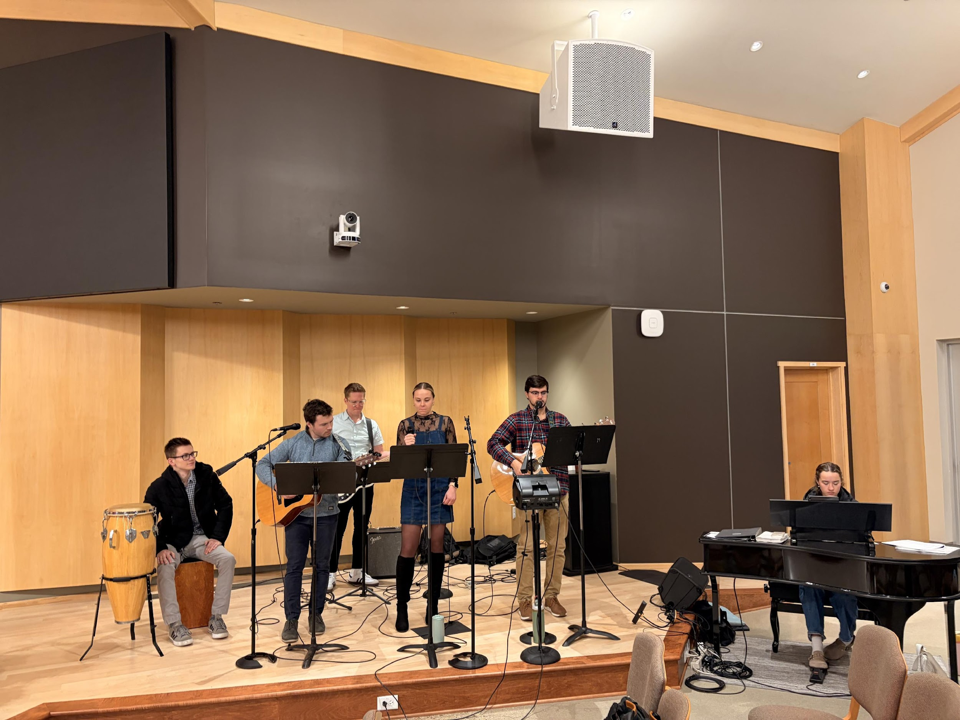
What’s working for us: 20 somethings involvement
Incorporating in services
Playing piano, singing in praise band
Worship nights
Growth groups
Leading AV
Personal connections with the Pastors and other Elders in the church
Notes:
This can be an Abby, Jared and Stella Show

Slide 18
To summarize CPR
Create a culture
Be authentic and welcoming
Build relationships
Always stop and assess if you have a pulse
(ex. is what we’re doing working?)
In all things God’s Will be done!
Notes:
This could be an all play a nice way for each person to take a point from above and comment on it, vs, ONE person Each of you take a point, and whatever two are left I’ll gladly speak on.
Start with a simple hello and let the Holy Spirit take it from there

Slide 19
Q&A
Notes:
If QR Code doesn’t work, I’d suggest we have me working the crowd with a portable MIC if needed and have the folks in attendance ask a question, if the question is directed to the 20 somethings. You folks have at it.
IF its pastoral related or how do you get your church to buy in type of question I can pull the Pastor card and take that one. Sound good?

Slide 20
Thank you

